Slide 1

Network Layer: IP Functions
Lecture 7 | CSE421 – Computer Networks
Department of Computer Science and Engineering School of Data & Science

Slide 2
Objectives
Short overview of the Network Layer
Packet Switching: Virtual Circuits & Datagram Networks
IP Fragmentation & Reassembly

Slide 3
















The Network Layer
Transport segment from sending to receiving host
On sending side encapsulates segments into packets
Network layer protocols in every host, router
Router examines header fields in all IP packets passing through it
On receiving side, delivers segments to transport layer
application
transport
network
data link
physical
network
data link
physical
network
data link
physical
network
data link
physical
network
data link
physical
network
data link
physical
network
data link
physical
network
data link
physical
network
data link
physical
network
data link
physical
application
transport
network
data link
physical
network
data link
physical
network
data link
physical

Slide 4
Functions of Network Layer
Forwarding: move packets from router’s input to appropriate router output
Analogy: process of getting through a single interchange
Routing: determine route taken by packets from source to destination
The algorithms that calculate the paths are referred to as routing algorithms.
Analogy: process of planning trip from source to destination
Has various routing algorithms
routing algorithm
local forwarding table
header value
output link
0100
0101
0111
1001
3
2
2
1
0111
1
3
2
value in arriving
packet’s header

Slide 5
Packet Switching: Virtual Circuits Datagram Network
Notes:
Data Communications and Networking. Behrouz A. Forouzan
Section 18.2

Slide 6
Connection and Connection-less service
The Internet Protocol is a connectionless service. Sometimes called
Datagram network =>
network-layer connectionless service
VC network => network-layer connection service
analogous to the transport-layer services, but:
service: host-to-host
no choice: network provides one or the other
implementation: in network core

Slide 7

Datagram networks
No call setup at network layer
Routers: no state about end-to-end connections
no network-level concept of “connection”
Packets forwarded using destination host address
packets between same source-dest pair may take different paths
application
transport
network
data link
physical
application
transport
network
data link
physical
1. Send data
2. Receive data

Slide 8
Virtual Circuits: Signaling Protocols
Used to setup, maintain teardown VC
Used in ATM, frame-relay, X.25
Not used in today’s Internet
application
transport
network
data link
physical
5. Data flow begins
6. Receive data
application
transport
network
data link
physical
4. Call connected
3. Accept call
1. Initiate call
2. incoming call

Slide 9
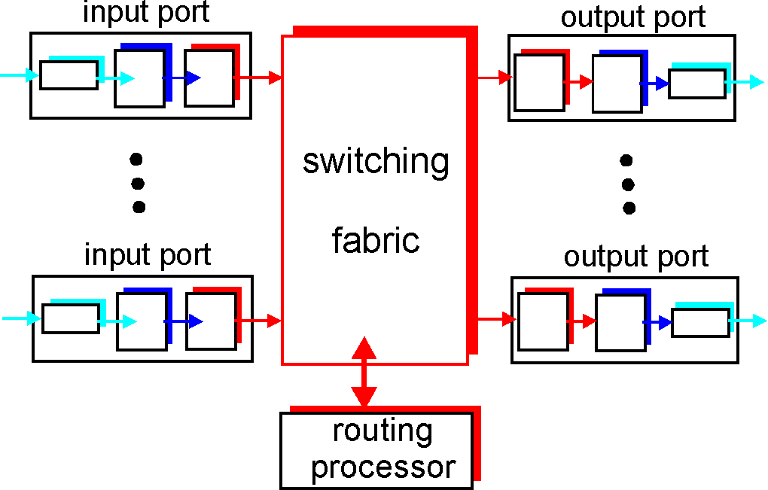
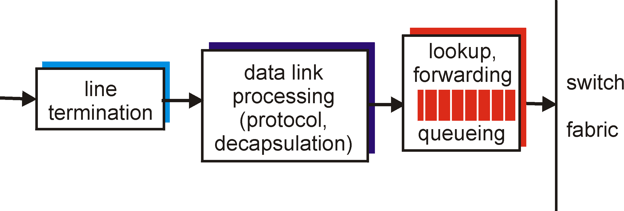
Functions of a Router
Run routing algorithms/protocol (RIP, OSPF, BGP)
Forwarding datagrams from incoming to outgoing link
Decentralized switching:
Given datagram dest., lookup output port using forwarding table in input port memory
Goal: complete input port processing at ‘line speed’
Queuing: if datagrams arrive faster than forwarding rate into switch fabric
Physical layer:
bit-level reception
Data link layer:
e.g., Ethernet

Slide 10
Internet Protocol

Slide 11
Internet Network Layer
Host, router network layer functions:
Transport layer: TCP, UDP
Routing protocols
path selection
RIP, OSPF, BGP
IP protocol
addressing conventions
datagram format
packet handling conventions
Network
layer
forwarding
table
ICMP protocol
error reporting
router “signaling”
Link layer
physical layer

Slide 12
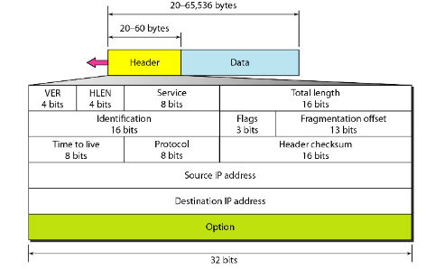
IPv4 Datagram Format
The size of an IP datagram:
The minimum size is 20 bytes (if you have no data)
The maximum size is 65,535 bytes
Notes:
19.1.1 Datagram Format (Data Communications and Networking. Behrouz A. Forouzan)

Slide 13
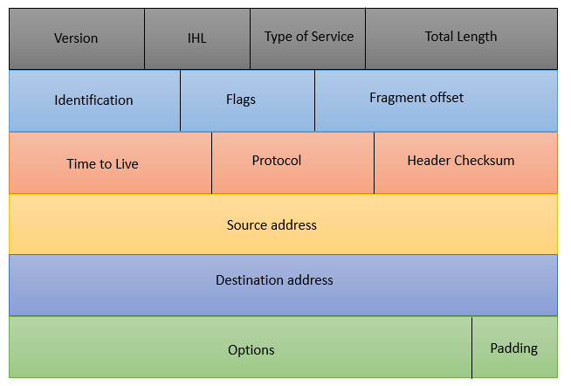
IPv4 Datagram Format
Version: 4 bits, value of which IP version is being used. For IPv4 the value will be 4 here.
Internet Header Length: 4 bits, value of the header length, min 20 bytes, max 60 bytes. Shown in 4 byte word. So min value 5, max 15.
Type of Service: 8 bits, for QoS (Quality of Service). To mark the packet to give special treatment or priority.
Total Length: 16 bits, value of the entire size of the IP packet (header and data) in bytes. The minimum size is 20 bytes (if you have no data) and the maximum size is 65.535 bytes.
Notes:
19.1.1 Datagram Format (Data Communications and Networking. Behrouz A. Forouzan)

Slide 14
IPv4 Datagram Format
Time to Live: 8 bits, value of how many hops can a packet. Used to prevent packets from looping around forever.
Protocol: 8 bits, value tells us which upper layer protocol is present, for example TCP has value 6 and UDP has value 17.
Header Checksum: 16 bits, to check if there are any errors in the header.
Options: 32 bits, value of any extra information
Notes:
19.1.1 Datagram Format (Data Communications and Networking. Behrouz A. Forouzan)

Slide 15

IP Fragmentation & Reassembly
Network links have MTU (max. transmission unit - max. transfer size) - largest possible link-level frame.
different link types, different MTUs
Large IP datagram divided (“fragmented”) within net
one datagram becomes several datagrams
“reassembled” only at final destination
IP header bits used to identify, order related fragments
fragmentation:
in: one large datagram (4000 bytes)
out: 3 smaller datagrams
Link MTU: 1500bytes
reassembly

Slide 16
IP Fragmentation & Reassembly
Example:
4000 Bytes of datagram
MTU = 1500 Bytes
Header + Data
Header size is usually 20 bytes
It can differ
Offset:
The value of the offset is measured in units of 8 bytes.
This is done because the length of the offset field is only 13 bits long and cannot represent a sequence of bytes greater than 8191.
This forces hosts or routers that fragment datagrams to choose the size of each fragment so that the first byte number is divisible by 8.
length
=4000
ID
=x
fragflag
=0
offset
=0
One large datagram becomes
several smaller datagrams
offset = 1480/8
1480 bytes in data field
length
=1500
ID
=x
fragflag
=1
offset
=0
length
=1500
ID
=x
fragflag
=1
offset
=185
length
=1040
ID
=x
fragflag
=0
offset
=370

Slide 17
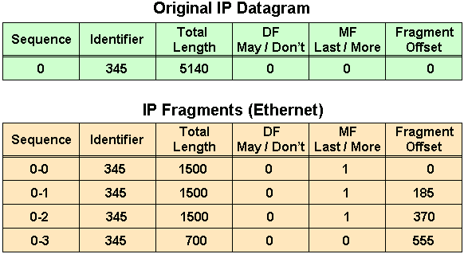
IP Fragmentation & Reassembly
MTU=20(H)+1480(D)
5140=20(H)+5120(D)
5120-1480=3640 (1st)
3640-1480=2160 (2nd)
2160-1480=680 (3rd)
680+20=700
Data Bytes | Fragment Offset
0 -1479 | 0/8=0
1480-2959 | 1480/8=185
2960-4439 | 2960/8=370
4440-5119 | 4440/8=555

Slide 18
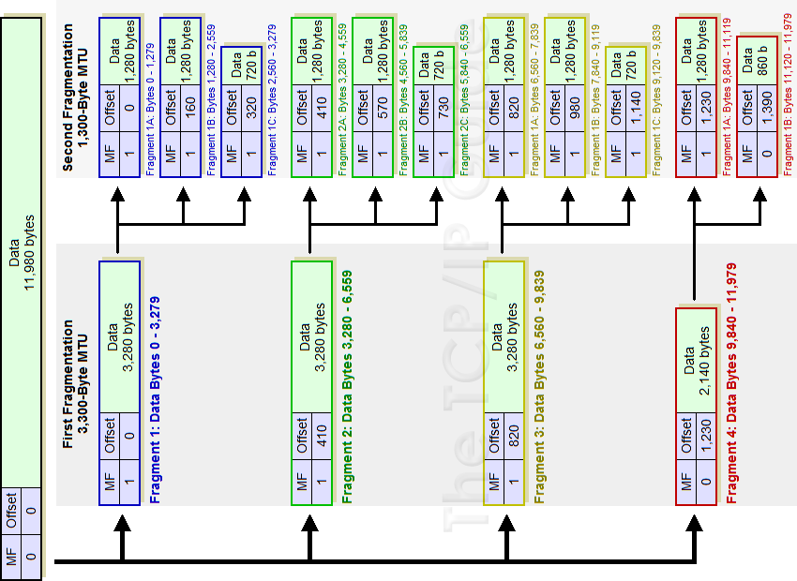
IP Fragmentation Example

Slide 19
IPv6

Slide 20
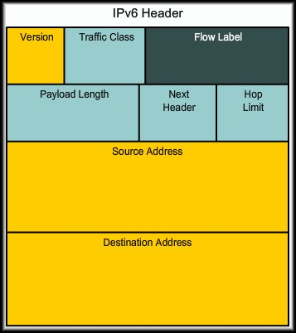
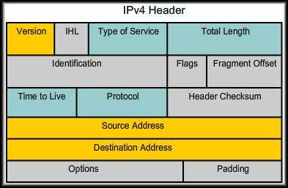
Reasons for Using IPv6
IPv6 Features:
fixed-length 40 byte header
no fragmentation allowed

Slide 21
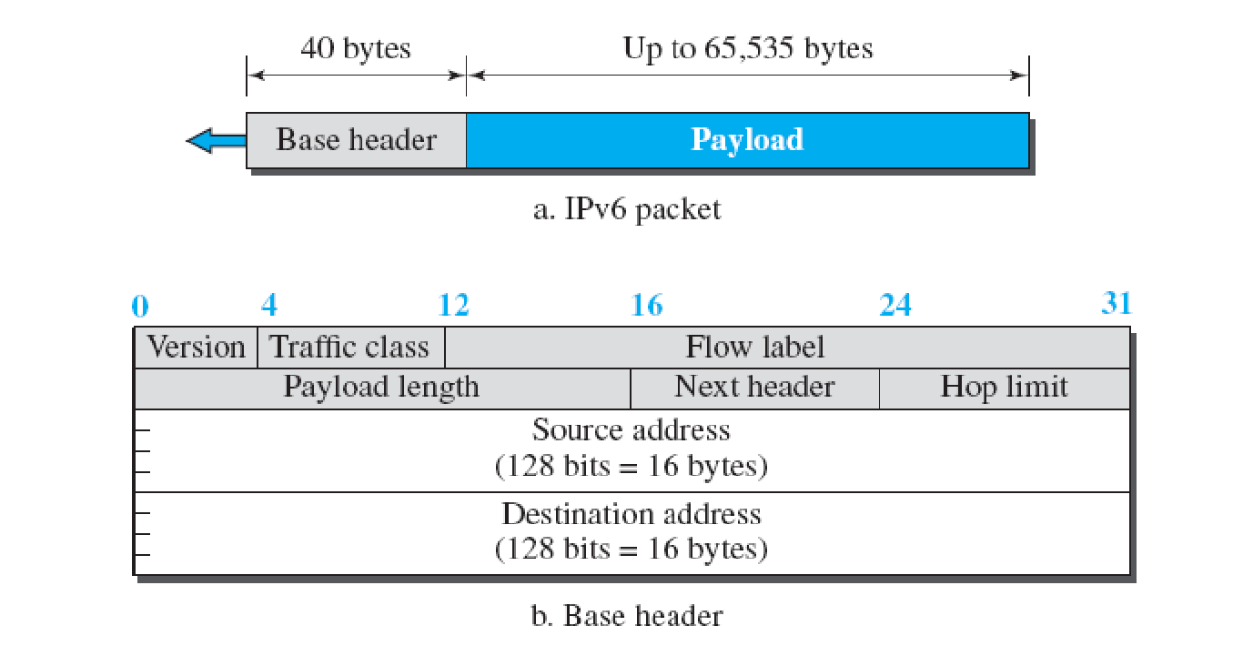
IPv6 Datagram
40 Octets, 8 fields

Slide 22
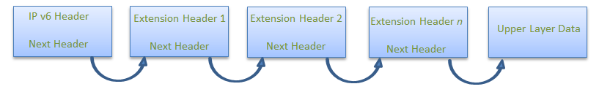
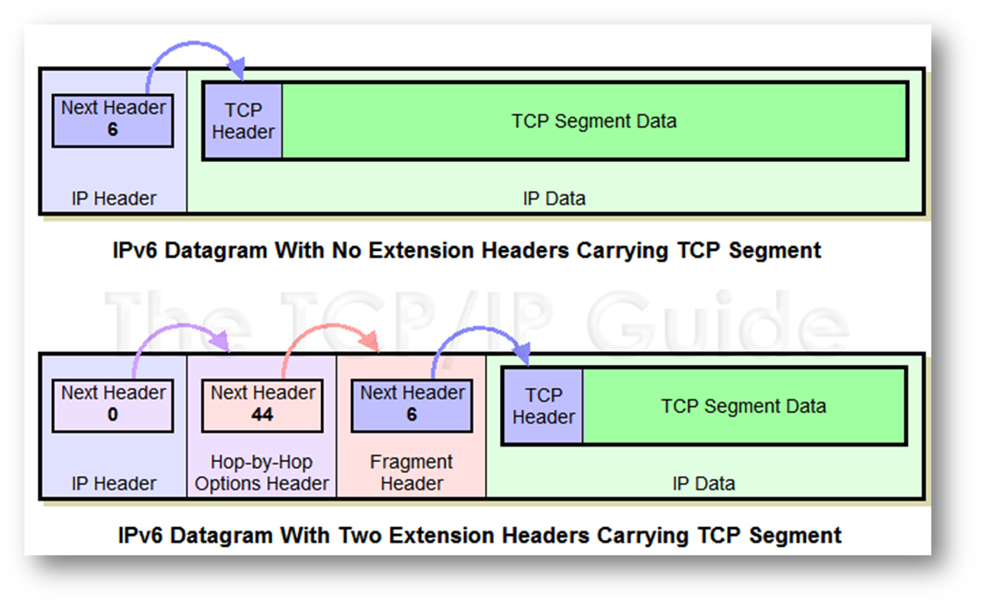
Extension Headers

Slide 23
The IPv4 Header
0
4
8
16
24
31
Ver
IHL
Service Type
Total Length
Identifier
Flags
Fragment Offset
Time to Live
Protocol
Header Checksum
32 bit Source Address
32 bit Destination Address
Options and Padding
shaded fields are absent from IPv6 header

Slide 24
Header Changes between IPv4 and IPv6
Revised
Time to Live (Hop Limit)
Addresses increased from 32 bits to 128 bits
Protocol (Next Header)
Precedence & TOS (Traffic Class)
Extended
Flow Label field added (Recommended read: Page 676 of Forouzan’s Book)

